Slide 1

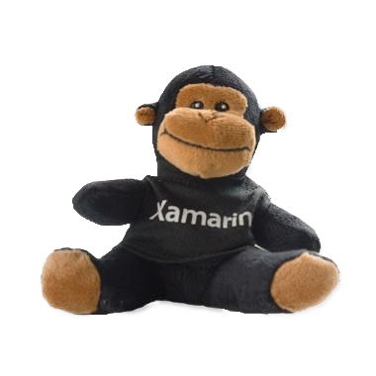

Slide 2

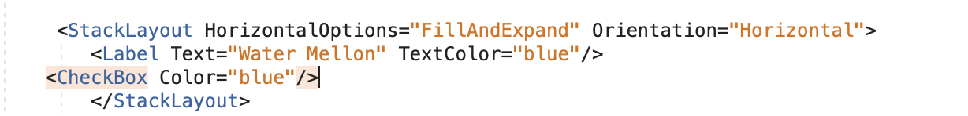
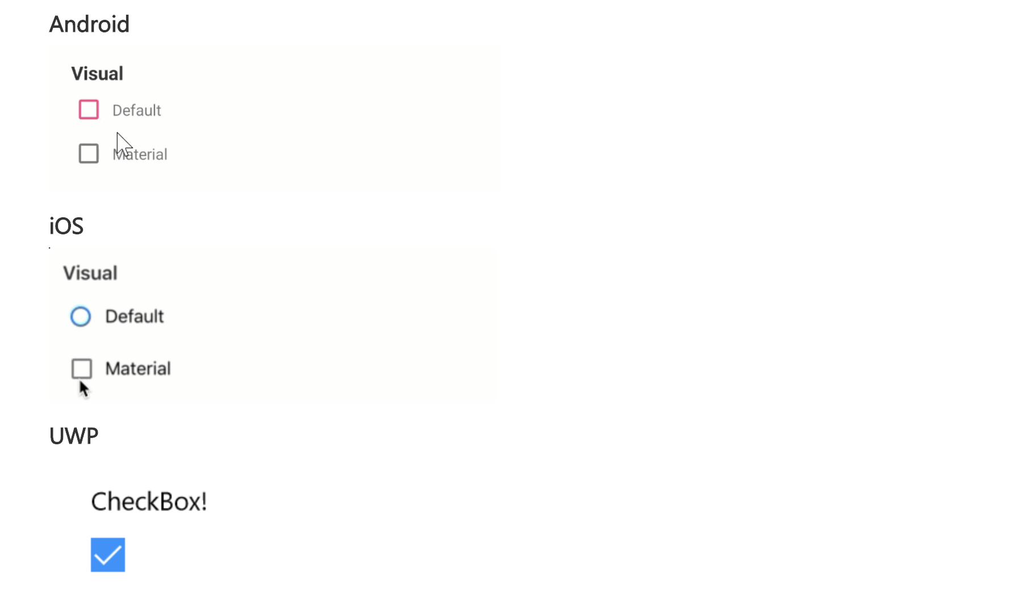
Check Box

Slide 3
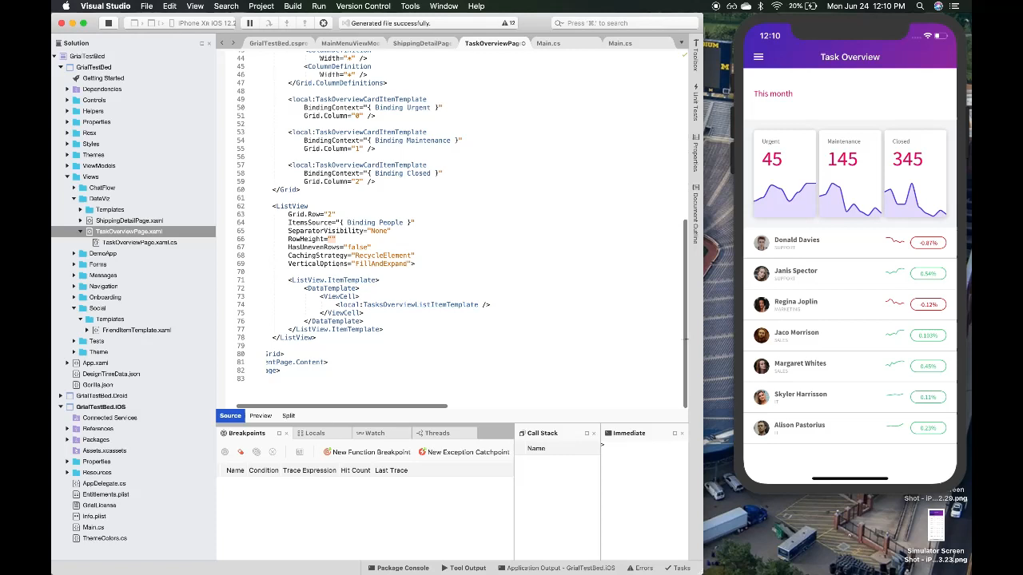
Xamarin hot reload

Slide 4
Xamarin Map
Awesome feature it is, Capturing the location on tap.
OnMapClicked event.

Slide 5
Faster Startup Times With Startup Tracing On Android

Slide 7
Getting Started
Differences in AOT Modes
Type | Startup Speed | APK Size
Normal | 2s914ms | 16.1 MB
AOT | 1s18ms | 34.6 MB
Startup Tracing | 1s518ms | 20.1 MB
Startup Tracing can be used with Visual Studio 2019 Version 16.2 or Visual Studio for Mac 2019 Version 8.2.
<PropertyGroup Condition=" '$(Configuration)|$(Platform)' == 'Release|AnyCPU' ">
<AndroidEnableProfiledAot>true</AndroidEnableProfiledAot>
</PropertyGroup>

Slide 8




THANK YOU
Anbu Mani
Associate Technical Analyst
https://xmonkeys360.com
@Anbu_Mani27
@AnbuMani27
@AnbuMani27
@AnbuMani27

